Slide 1
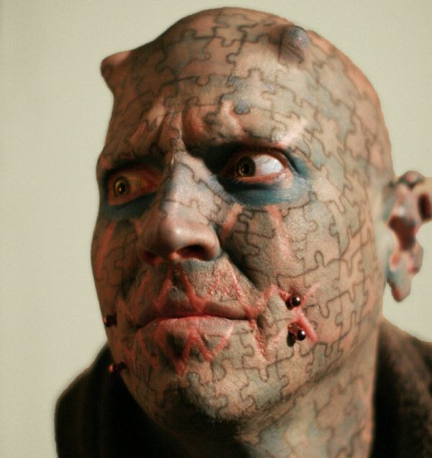
Deviance

Slide 2
What is deviance?
Deviance: any violation of norms.

Slide 3
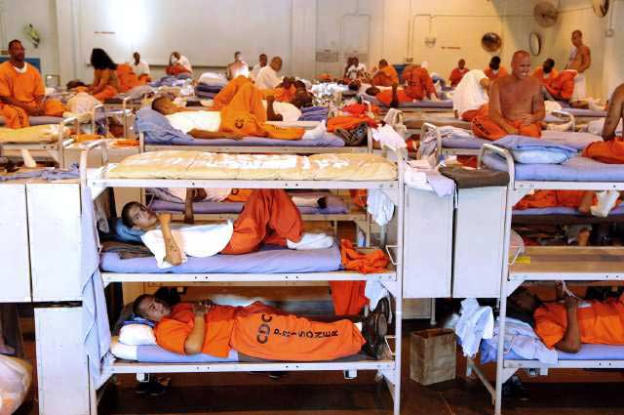
Deviant actions or attitudes have the common element of “different” which causes society to regard the deviant person as an “outsider”.

Slide 4
What do you notice about this definition?
The definition is VERY VAGUE.
It is not the act itself, but the reactions to the act, that make it deviant.

Slide 5
When sociologists use the term “deviant,” they are making a social judgment, never a moral one.
If a particular behavior is considered deviant, it means that it violates the values and norms or a particular group, not that it is inherently wrong.

Slide 6
Write down a few acts or attributes that you consider to be deviant. Acts: something you do (play baseball) Attribute: a quality or characteristic you have (being a student)

Slide 7
Relativity of Deviance: what is deviant to some is not deviant to others. SYMBOLIC INTERACTION What are some examples of the relativity of deviance.

Slide 8
Sometimes, to be deviant, a person doesn’t have to actually DO anything. Stigma: characteristics that discredit people. - Violations of norms of ability (blindness) - Violations of norms of appearance (birthmarks)

Slide 9
Norms make social life possible because they make life predictable. This is why deviance can be seen as threatening. Deviance undermines the predictability of social life.

Slide 10
Social Control: attempts by society to regulate thoughts and behaviors. - Negative sanctions: expressions of disapproval of deviance - Positive sanctions: rewards for conforming to norms.

Slide 11
HOMEWORK Given the definition of deviance can cheating still be regarded as deviant? Explain your answer.

