Slide 1
The Limbic System Emotions, Memories and More!

Slide 2
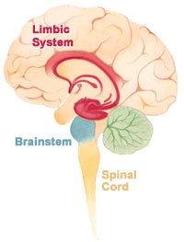
Collection of structures that give humans enhanced capacity for memory, emotions and motives.

Slide 3
The Limbic System *Processes memories *Regulates complex emotions and motives *Feelings of pleasure and pain *Produces fear and rage

Slide 4
Amygdala * Influence aggression and fear * Involved in memory and emotion. Which division of the autonomic NS is activated when the amygdala is stimulated? (Sympathetic/parasympathetic)?

Slide 5
Hippocampus * Connects present with past * Remembers locations of things in space * H.M. – living in 1953 * Vital part of memory system

Slide 6
Hypothalamus *Bodily maintenance * Hunger, thirst, body temp * Monitors blood * Works with other parts of the brain

Slide 7
Hypothalamus * Reward centers (pleasure centers) * Release of dopamine * Eating, drinking and sex * Reward deficiency syndrome

Slide 8
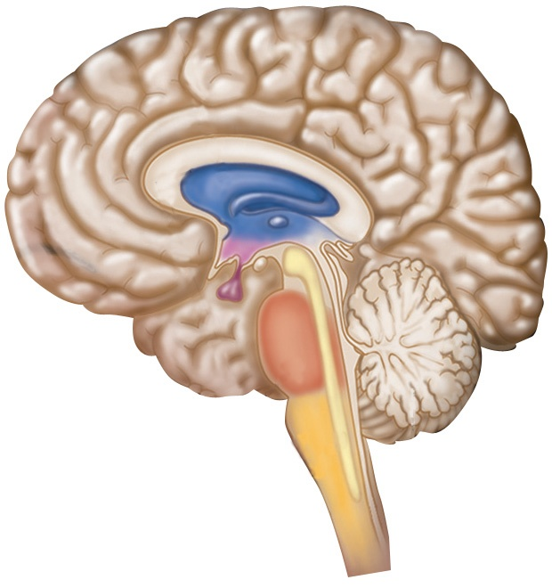
Amygdala:
Hypothalamus:
Hippocampus:

Slide 9
The Brain Crash Course

