Slide 1
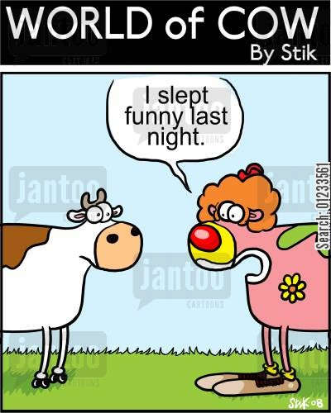
Sleep
Do you get enough of it?

Slide 2
Cycles of Consciousness
Consciousness changes in cycles that corresponds to our biological rhythms and to the patterns of stimulation in our environment.

Slide 3
Daydreaming:
- mildly altered state of consciousness
- attention turns to memories, expectations and desires
- occur when people are alone, relaxed, bored or doing something routine

Slide 4
Where do you daydream the most?
In what environments?
Are there any commonalities to your daydreams?

Slide 5
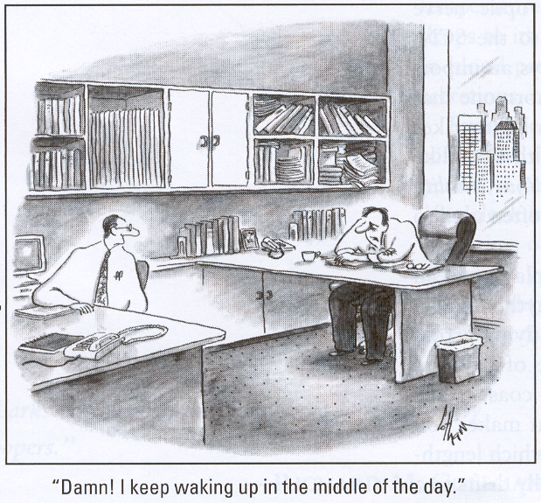

Slide 6
Sleep
- How do biological rhythms influence sleep and dreaming?

Slide 7
Sleep IQ Test
1. During sleep your brain rests.
2. You can not learn to function normally with one or two fewer hours of sleep a night than you need.
3. Boredom makes you feel sleepy, even if you have had enough sleep.
4. Resting in bed with your eyes closed cannot satisfy your body’s need for sleep.
5. Snoring is not harmful, as long as it doesn’t disturb others or wake you up.
6. Everyone dreams at night.

Slide 8
Sleep IQ Test
7. The older you get, the fewer hours of sleep you need.
8. Most people don’t know when they are sleepy.
9. Raising the volume of your radio will help you stay awake while driving.
10. Sleep disorders are mainly due to worry or psychological problems.
11. The human body never adjusts to night shift work.
12. Most sleep disorders go away, even without treatment.

Slide 9
Sleep IQ Answers
1. During sleep your brain rests.
False: While your body rests, your brain doesn’t.
2. You can not learn to function normally with one or two fewer hours of sleep a night than you need.
True: Sleep need is biological. While children need more sleep than adults, how much sleep any individual needs is genetically determined.
3. Boredom makes you feel sleepy, even if you have had enough sleep.
False: Boredom only unmasks sleepiness, but it doesn’t cause it.
Notes:
1. False. An active brain during sleep prepares us for alertness and peak functioning the next day.
2. True Most adults need 8 to 8 ½ hours of sleep a night. How to determine what you need? Sleep until you wake on your own...without an alarm clock. Feel rested? That's your sleep need. You can teach yourself to sleep less, but not to need less sleep.
3. False Boredom doesn’t cause sleepiness,it only unmasks it because when you are bored you are more likely to notice that you are sleepy.

Slide 10
Sleep IQ Answers
4. Resting in bed with your eyes closed cannot satisfy your body’s need for sleep.
True: Sleep is as necessary to health as food and water, and rest is no substitute for sleep.
5. Snoring is not harmful, as long as it doesn’t disturb others or wake you up.
False: Snoring may be a signal for sleep apnea (which can be fatal if untreated).
6. Everyone dreams at night.
True: Every person dreams every night – it’s just that some of us can’t remember much of our dreams.
Notes:
4. True When you don’t get the sleep you need, your body builds up a sleep debt. Sooner or later, this debt must be paid…with sleep. If you drive when you are sleep, you place yourself and others at risk because drowsy drivers can fall asleep at the wheel with little or no warning. Sleepiness contributes to inattention, which is related to 1 million crashes a year!
5. False
6. True

Slide 11
Sleep IQ Answers
7. The older you get, the fewer hours of sleep you need.
False: Although we tend to sleep less, our need for sleep doesn’t decrease as we age.
8. Most people don’t know when they are sleepy.
True: We are not very good judges of our biological need for sleep.
9. Raising the volume of your radio will help you stay awake while driving.
False: The only short-term solutions are to pull over and take a nap or to have a caffeinated drink.
Notes:
7. False Older people may wake more frequently through the night and may sleep less, but their sleep need is no less than during young adulthood. When older people sleep less at night, they tend to sleep more during the day. Sleep difficulties are not a normal part of aging, although they are all too common. If poor sleep habits, pain or health conditions make sleeping difficult, a physician can help.
8. True
9. False

Slide 12
Sleep IQ Answers
10. Sleep disorders are mainly due to worry or psychological problems.
False: Sleep apnea is caused by relaxed muscles and narcolepsy appears to be genetic.
11. The human body never adjusts to night shift work.
True: No matter how long you work a night shift, sleeping during the day remains a challenge because of our circadian rhythms that operate on the light/dark schedule.
12. Most sleep disorders go away, even without treatment.
False: On average, sleep disorders do not disappear without treatment.
Notes:
10. False No one knows yet what causes restless legs syndrome, in which creepy, crawly feelings arise in the legs and are relieved, momentarily, by motion.
11. True
12. False Treatment includes behavioral (avoiding caffeine before bedtime, losing weight – for sleep apnea), pharmaceutical, surgical, or some combination.

Slide 13
Biological Rhythms
* 24 hour clock (circadian rhythm)
* 90 minute sleep cycle (5 stages)

Slide 14

The Stages of Sleep
5 stages
  First four stages are non-REM
  Fifth, and final, stage is REM
Stage 1
  Alpha Waves
  Hypnic jerks (falling)
  Lasts about 10 minutes
  This is the transition from relaxed wakefulness to sleep
Notes:
In the early 1960’s, sleep researchers found that they could measure and catalog stages of sleep by measuring your EEG (electroencephalogram) brain activity. Wakeful activity is characterized by beta waves - a ‘desynchronized mixture of many frequencies but dominated by waves of relatively fast frequencies’. As you become drowsy, EEG recordings show a slower, larger, and somewhat more regular pattern on alpha waves. For a minute or two, you drift into a hypnogogic state in which you may imagine seeing flashes of color or light or perhaps you jerk your leg abruptly as you sense yourself falling. You are entering stage 1 sleep. Electrical activity in the brain slows down some more, in a pattern of theta waves. Your breathing becomes more regular, your heart rate slows, and your blood pressure drops. This is a period of very light sleep.
With sleep, we have five stages, four of which are non-REM sleep and one REM stage.

Slide 15
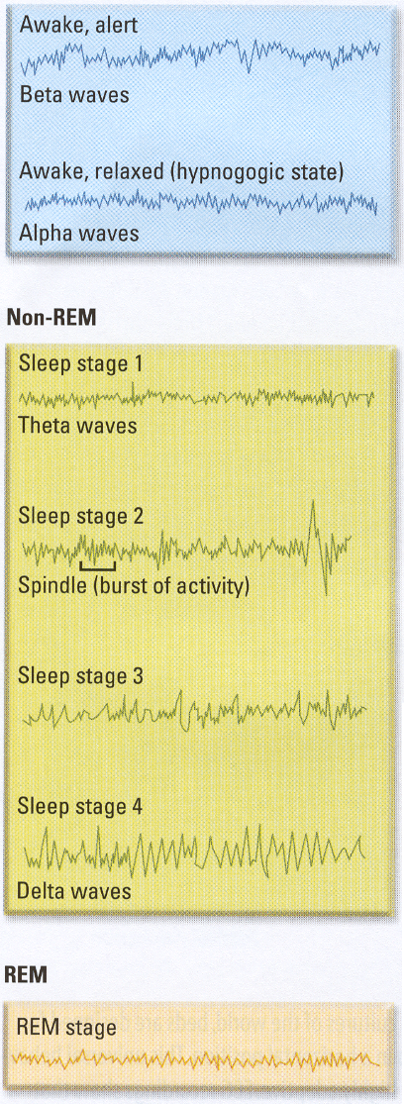
The Stages of Sleep
Stage 2
  Sleep spindles
  Lasts about 20 minutes
Stages 3
  Transitional stage
  Stage 4
    Delta Waves
    Difficult to wake up
Notes:
After about 10 minutes in stage 1 sleep, your EEG pattern shows waves that are even slower and larger. As you slip into stage 2 sleep, you become progressively more relaxed, the rolling eye movements stop, and you become less easily disturbed. On the EEG, stage 2 is marked by periodic short bursts of activity called sleep spindles. If someone makes a noise, your brain will register a response – but you will probably not wake up. Stage 2 lasts about 20 minutes.
So after about 20 minutes in stage 2, you fall into the deepest stages of sleep. Stages 3 and 4 are hard to distinguish because they differ only in degree. Both are marked by the onset of very slow waves with large peaks, called delta waves, which last for about 30 minutes. Delta waves seem to indicate that increasing numbers of neurons are firing together, in synchrony. At this point, you are ‘out like a light’ or ‘sleeping like a rock'. If the phone rings, you may not hear it. If you do answer the call, you’ll sound dazed and confused. It is during the very deep sleep of stages 3 and 4 when young children may wet the bed or when you may walk or talk in your sleep. It’s this stage that Mark Twain had in mind when he said ‘There ain’t no way to find out why a snorer can’t hear himself snore.’ Yet in keeping with the adaptive and very selective nature of attention, certain noises will penetrate consciousness. New parents may be oblivious to the sounds of traffic outside, for example, but they're quick to hear they new baby cry.

Slide 16
The Stages of Sleep
REM
  Go back through stages 3 and 2
  Rapid, raw-toothed brain waves
  Brainstem blocks all message – paralyzed state
  Paradoxical sleep
  Marked by more vivid, detailed, and story like dreams
    We dream during all stages but these are more visual
Notes:
After an hour of deepening sleep, something odd happens. Rather than maintain your deep sleep, you begin to cycle backward to stage 3, then to stage 2. But then instead of returning to stage 1, you enter a new, fifth stage, marked by two dramatic type of changes. On the one hand, the EEG reveals a surge of short, high-frequency beta waves like those found when you were awake. Also indicating an increased level of activity, blood flow to the brain increases, your breathing and pulse rates speed up, and your genitals become aroused – even without sexual thoughts or dreams. On the other hand, you have lost skeletal muscle tone throughout the body. In fact, your arms, legs and trunk are so totally relaxed that, except for an occasional twitch, you are completely paralyzed. You’re also hard to awaken at this stage. This odd combination of being internally active but externally immobile – has led some researchers to refer to this stage of sleep as paradoxical.
The most prominent change occurs in the eyes. The eyelids are shut, but underneath, your eyeballs are darting frantically back and forth as if you were watching a world-class Ping-Pong match. These rapid eye movements are so pronounced that this stage has been named REM sleep – and it is contrasted with stages 1 through 4, which are lumped together as non-REM sleep. What makes rapid eye movements so special is what they betray about the state of your mind. When sleeping subjects are awakened during non-REM sleep stages, they report on dreams about ½ the time. Yet when subjects are awakened during REM sleep, they report on dreams about 80% of the time – and that includes subjects who came into the lab saying that they don’t every dream. Clearly, everyone dreams throughout the night, during both REM and non-REM sleep. But compared to the fleeting thoughts and images reported during stages 1 through 4, REM dreams are more visual, vivid, detailed, and storylike. Inn the mind’s late-night theater, the production of dreams can be seen in the resurgence of activity within the eyes and brain.
From the time you fall asleep, it takes about 90 minutes to complete one cycle. The contrasts within the cycle are striking. Non-REM sleep has been described as ‘an idling brain in a moveable body’ and REM sleep as ‘an active brain in a paralyzed body’. In a full night’s sleep, you are likely to recycle through the stages between four and six times. The first time through the cycle, you spend only about ten minutes in REM sleep. As the night wears on, however, you spend less time in the deeper non-REM periods and more time in REM sleep. During the last hour before you awaken in the morning, the REM period is 30 to 60 minutes long. This explains why people are so often in the middle of a dream when that mechanical tyrant we call an alarm clock goes off.

Slide 17
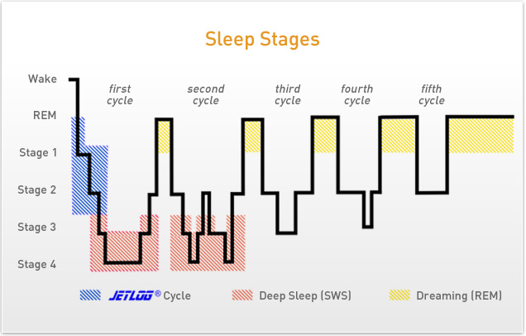
STAGES OF SLEEP

Slide 18
Each cycle lasts roughly 90 minutes
Approximately 4 to 6 cycles per night
The first time through the cycle, you only spend about 10 minutes in REM – which increases to 30 to 60 minutes by the last cycle

Slide 19
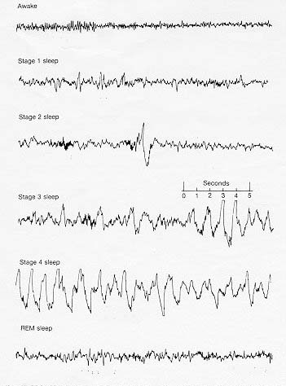
SLEEP STAGES:

Slide 20
Why do we sleep?
Restorative theories
  Sleep rejuvenates us
    Amount of slow wave sleep depends on how long we’ve been awake
Circadian theories
  Evolutionarily, it has survival value
    Amount of REM sleep depends on circadian rhythm
Notes:
Because humans spend a third of their lives in this state, its natural to wonder: Why do we sleep? When we are tired, the urge to doze is overwhelming and very hard to fight, regardless of what we’re doing or where we are (trust me, I see it…even in this class!). And if we are still tired when the alarm clock rings, we might grope for the snooze button or just pretend we didn’t hear it – even if we have a schedule to keep. Our need for sleep is powerful and irresistible. But why?
One way to investigate this question is to look at what happens when people are deprived of sleep. You’ve all probably pulled all-nighters, but probably not for periods of time that are long enough to really push your limits. In 1964, 17-year old Randy Gardner sought fame in the Guinness Book of World Records. As part of a high school science project, and with the help of two friends, Gardner stayed awake for 264 hours – eleven straight days, which at the time was a world record. When it was over, he held a news conference, during which he said ‘It’s just mind over matter’. He went to sleep for fifteen hours, woke up feeling fine, and resumed his normal schedule. Follow-up tests confirmed that Garnder suffered no long-term ill effects. BUT daily tests administered to Gardner showed that his thinking was fragmented, his speech slurred, he couldn’t concentrate, he had memory lapses, and toward the end, he was hallucinating.
The world record holder is Bertha van der Merwe of Capetown, South Africa. In 1968, she stayed awake for almost 283 hours – the equivalent of 11 days, 18 hours, and 55 minutes.
On the basis of these episodes and many studies, sleep researchers have concluded that sleep is a necessary function. There are two types of explanations for why this is so. One comes from Restoration Theory which states that sleep recharges the battery, enabling us to recover from the day’s physical, cognitive, and emotional demands. This theory explains why people feel run-down as the day wears on and refreshed after a night of sleep.
It’s also supported by research on the effects of prolonged sleep deprivation in laboratory rats. In a series of experiment, Allan Rechtschaffen an his colleagues placed rats on a circular platform surrounded by cold water and monitored their EEG patterns. There was ample food and the temperature was set at a suitable level. Whenever the EEG showed that the rat was falling asleep, however, the platform would slowly rotate, causing the rat to move in order to avoid being pushed into the water (the control rats were similarly treated but were permitted to sleep). The results were striking. After 24 hours of sleep deprivation, the rats fell into unusually long periods of slow-wave deep sleep, suggesting that their brains were compensating for the prior loss. Two to three weeks of sleep deprivation resulted in a lowered body temperature, increased food intake, increased metabolism, weight loss, and a breakdown of the immune system.
A second type of explanation for why we sleep comes from the circadian theory, which focuses on the evolutionary significance of sleep. All animals sleep or undergo regular intervals of inactivity. According to this view, sleep is a neural mechanism that has evolved over time so that animals can conserve energy and minimize their exposure to predators when they are not foraging for food or seeking a mate. Circadian theory correctly predicts that there are species-specific differences in sleep patterns. Animals that sleep the longest find food easily and are well hidden from predators while sleeping. In contrast, animals that sleep the shortest mount of time spend more hours foraging and can defend themselves only by running away. Seen from this perspective, we humans sleep at night because we’re not very well adapted to searching for food in the dark or protecting ourselves from nocturnal predators.
The question of why humans sleep is still something of an unsolved mystery. Restoration and circadian theories do no contradict one another, and many researchers believe that both mechanisms are at work.

Slide 21
STAGES OF SLEEP

Slide 22
Normal Sleep Features
1. 90 minute cycles
2. Deepest sleep near beginning of night
3. Increase in REM as your sleep progresses

Slide 23
Sleep Disorders
Insomnia
  Chronic problems in getting good sleep
  Difficulty in falling asleep, staying asleep
  Causes
    Stress, depression, health problems
  Solutions
    Sedatives aren’t always effective and should never be a long-term solution!!!
    Don’t take naps during the day
    Avoid alcohol, caffeine, and cigarettes within 5 hrs before bedtime (avoid exercise within 2 hrs)
    Keep a rigid schedule – going to bed and waking up at the same time
Notes:
At some point in life, nearly everyone suffers from a sleep-related problem. You lie in bed, tossing and turning, brooding over something that happened or worrying about something that might. Or you keep nodding off in class or in other embarrassing situations. In general, there are three types of disturbances: sleeping too little (insomnia), sleeping too much (hypersomnia) and having disturbed or troubled sleep (parasomnia).
The sleep disturbance known as insomnia is characterized by a recurring inability to fall asleep, stay asleep, or get the amount of sleep needed to function during the day. Very few of us adhere to the daily ‘ideal’ of eight hours for work, eight for play, and eight for sleep. On the contrary, people differ in the amount of sleep they want. Some are at their most alert after six hours a night whereas others need nine or ten hours to get along. How much time is sufficient depends on who you are.
About 30% of the population complain of insomnia – and roughly half of these people consider the problem to be serious. It’s not easy to know when someone has insomnia based on self-report, however. In a study that illustrates this point, a researcher brought 122 insomniacs into the laboratory and compared their self-perceptions to EEG measures of sleep. The next morning, the subjects that it took them an hour to fall asleep and that they slept for 4 ½ hours. But EEG tracings revealed that it took them only 15 minutes to fall asleep, which is average, and that the slept for 6 ½ hours. More than 10% of all complaints are from pseudoinsomniacs who sleep normally but don’t realize it. Part of the problem is that people with insomnia worry so much about getting to sleep, and then getting enough sleep, that they monitor themselves closely and overestimate the extent of the problem.
Among people who do have trouble falling or staying asleep, insomnia is not a disease but a symptom with many causes. On average, psychiatric patients get less sleep than do people without mental disorders. Medical ailments, pain, stress, depression, jet lag, night work, shifting work schedules, old age, and alcohol and drug abuse are also linked to insomnia. In some cases, the only ‘problem’ is that people who think they should sleep eight hours a night go to ed before they’re really tired. The use of medications may also pose an ironic danger. Certain over-the-counter sleeping pills are not effective. Some prescription drugs will, at first, put the insomniac to sleep and prevent rude awakenings during the night. But sedatives may also inhibit certain stages of sleep and cause restlessness after the drug is terminated. Numerous studies have shown that most people can successfully overcome insomnia by altering their behavior – but that the benefits are smaller for those who take sleeping pills.
Some tips for dealing with insomnia.

Slide 24
Sleep Disorders
Narcolepsy
  Being sleepy during the day and sleeping too much at night
Sleep Apnea
  “with no breath”
Night Terrors
Notes:
About 5% of people suffer from hypersomnia – being sleepy during the day and sleeping too much at night. The most profound and dangerous problem of this type is narcolepsy, which means ‘sleep seizure’ and is an uncommon disorder that is characterized by sudden, irresistible attacks of drowsiness and REM sleep during the day.
A narcolepsy attack may strike without warning at any time – while playing basketball, eating a meal, having a conversation, or having sex. The attack lasts from five to thirty minutes and plunges its victim into REM sleep. The narcoleptic’s jaw will sag, the head will fall forward, the arms will drop, and the knees will buckle. This collapse is sometimes accompanied by the hypnogogic hallucinations that usher in the onset of sleep. As you might imagine, people with narcolepsy have problems at work and with their social lives. For example, they are often unfairly perceived to be lazy and uninterested. It can also be life threatening. In one study, 40% of narcoleptics admitted to having fallen asleep while driving. Although, there is no cure, daytime sleeping attacks can be minimized by taking regularly scheduled naps and stimulant drugs.
For some people, falling asleep at night and staying awake during are not a problem – but too often their sleep is disturbed.. There are several specific disorders of this type. One particularly troublesome disturbance is sleep apnea which afflicts between 1 and 4% of the population, mostly obese men. A person with sleep apnea will fall asleep normally but then stop breathing and awaken snorting like a buzz saw, choking, and gasping for air. Sleep-lab studies show that a person with sleep apnea will fall asleep again right away, but these partial awakenings can recur four hundred times during the night, thus preventing slow-wave sleep and making the person excessively tired and irritable during the day. There has been some success with surgery or by having the patient wear a plastic mask that gently pumps air into the nose. The air holds the throat open, which may prevent the closing that causes the sleep disturbance.
Nightmares are vivid, anxiety-provoking dreams that sometimes haunt us during REM sleep – and awaken us. They are common, particularly among children, and should not be a cause for concern unless they persist for long periods of time. About four out of five college students report having had at least one nightmare over the past year, with an average of about 11 nightmares a year.
There are also non-REM sleep disruptions. In night terrors, the person jolts abruptly from a deep sleep, in a state of panic, and gives off a loud, bloodcurdling scream. As with nightmares, this problem is more common among children than among adults. It’s also more frightening, particularly for others in the household. Because it occurs in non-REM sleep, however, the night terror victim will usually not recall a dream and by morning will have forgotten the whole episode.
Another non-REM experience is sleepwalking, in which a sleeper quietly sits up, climbs out of bed, and walks about with eyes open and a blank expression. Sleepwalkers may start slowly, but soon they’re going to the bathroom, dressing, eating, and opening doors. They are prone to accidents, such as falling down stairs, so it is safer to gently awaken a sleepwalker than to allow the person to wander about. People used to think that sleepwalkers were acting out dreams. But that’s not the case. These episodes occur early in the night, during the deep, slow-wave stages of sleep. Sometimes sleepwalkers will wake up and be disoriented, but most often they just go back to bed. Like night-terror victims, sleepwalkers seldom recall their travels in the morning. In a rare and particularly curious variant of the problem, some individuals are said to have engaged in ‘sleepsex’ – sexual acts performed while asleep. Clearly, the brain is active even during sleep – and clearly, consciousness is complex and multilayered.

Slide 25
Homework:
Read article about teenage sleep shortages. Write a letter to Mr. Thorsen suggesting a solution to the problem of chronically tired students.

