Slide 1
Operant Conditioning

Slide 2
Operant Conditioning: association between actions and consequences Actions followed by reinforcers -- increase Actions followed by punishment --decrease

Slide 3
* Voluntary behaviors are controlled by reward and punishment. * When reward and punishment are involved there is a different form of learning involved. * In operant conditioning, the consequences of the behavior influence the chance the behavior will occur again.

Slide 4
BF Skinner * Law of Effect: rewarded behavior is likely to recur * Operant chamber (Skinner Box)

Slide 5
* Believed the most powerful influences on behavior are consequences * Did not care about feelings, intentions or goals – these are too subjective to study successfully

Slide 6
Reinforcer: any conditions that follows and strengthens a response (desired behavior). Examples?

Slide 7
Basic Types of Reinforcers

Slide 8
Positive Reinforcement: ADDS a pleasurable stimulus Negative Reinforcement: the REMOVAL of an unpleasant or averse stimuli

Slide 9
NEGATIVE REINFORCEMENT IS NOT PUNISHMENT. Negative reinforcement REMOVES a punishing event.

Slide 10
Punishment: a consequence that decreases the frequency of a preceding behavior.

Slide 11
Positive Punishment: application of an aversive stimulus Negative Punishment: removal of a reinforcer

Slide 12
Punishment – What’s the problem? 1. Punished behavior is not forgotten 2. Punishment teaches discrimination 3. Punishment can teach fear 4. Physical punishment may increase aggressiveness

Slide 13
Reinforcement or Punishment? Ask yourself: 1. Is something added or taken away? 2. Does behavior increase or decrease?

Slide 14
1. Is something being added or taken away? (Added = positive or Taken Away = negative) 2. Does the behavior increase or decrease? (Increase= reinforcement or Decrease = punishment)

Slide 15
Punishment and Negative Reinforcement are used to produce opposite effects. Punishment: used to decrease a behavior Negative Reinforcement: used to increase a behavior

Slide 16
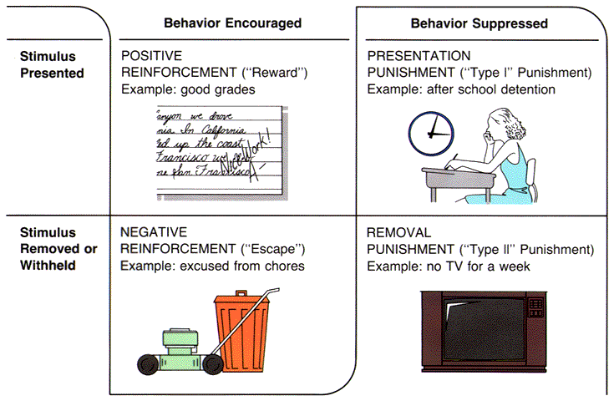

Slide 17
Sometimes negative reinforcement and positive reinforcement happen at the same time….

Slide 18
Primary reinforcers: Unlearned, innately satisfying Secondary reinforcers: reinforcing power based on learned association

Slide 19
Reinforcement V. Punishment Practice Worksheet

Slide 20
Continuous Reinforcement: All correct responses are reinforced Intermittent Reinforcement: Rewarding of some, but not all, correct responses.

Slide 21
* Timing and frequency are important * Humans can respond to delayed reinforcers * It is better to delay your gratification (Marshmallow experiment…)

Slide 22
Schedules of Reinforcement Ratio Schedule: rewards subject after a certain number of responses Interval Schedule: provides a reward after a time interval

Slide 23
Ratio Schedules Fixed Ratio: reinforcement based upon certain, unvarying number of responses Variable Ratio: Reinforcement based on varying responses

Slide 24
Interval Schedules Fixed Interval: reinforcement is based upon a certain, fixed time period Variable Interval: reinforcement varies in time period

Slide 25
Intervals Practice Worksheet

Slide 26
Reminder! Positive = to add Negative = to subtract

Slide 27
Positive reinforcement and positive punishment = adding a stimulus Negative reinforcement and negative punishment = removal of a stimulus

Slide 28
Application of Operant Conditioning * Individualized instruction * Sports * Work * At home

Slide 29
Operant Conditioning in your life homework… 1. State goal 2. Monitor desired behavior 3. Reinforce desired behavior 4. Reduce rewards gradually

Slide 30
Comparison
Classical Conditioning
Operant Conditioning
Behavior controlled by stimulus before response
No reward or punishment
New stimulus produces “old” behavior
Extinction can happen
Learner is passive, responses are involuntary
Behavior controlled by consequences
Often involves reward or punishment
New stimulus produces new behavior
Extinction can happen
Learner is active, responses are voluntary

Slide 31
Create a skit to illustrate either reinforcement or punishment.

