Slide 1
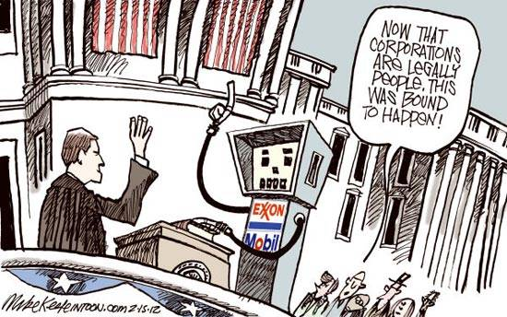
WHAT DO CORPORATIONS AND THE FIRST AMENDMENT HAVE TO DO WITH POLITICS?

Slide 2
Citizens United v. F.E.C. (2010) Reading #1

Slide 3
Do you agree or disagree with Mr. Carvin when he says “that a ban on spending money to speak is no different than a straight forward ban on speech”?

Slide 4
* Court case dealing with regulation of campaign spending by organizations * 1st Amendment prohibits government from restricting political spending by non profit organizations (corporations and unions, too)

Slide 5
Organizations may not contribute directly to political campaigns

Slide 6
PAC: Gets $ from donors and uses money to campaign

Slide 7
SUPER PAC: Unlike traditional PACs, they can raise funds from individuals, corporations, unions, and other groups without any legal limit on donation size *Made possible by Citizens United case

Slide 8
501(C)(4): politically active nonprofit organizations dedicated to social welfare. May participate in political campaigns and elections, as long as their primary activity is the promotion of social welfare not required to disclose their donors

Slide 9
CITIZENS UNITED V. FEC
What do you think? Pro and Pro Con and Con

Slide 10
2012 Presidential Election

Slide 11
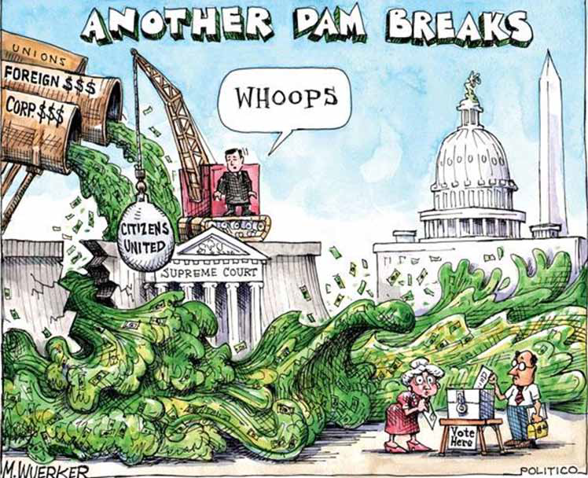

Slide 12
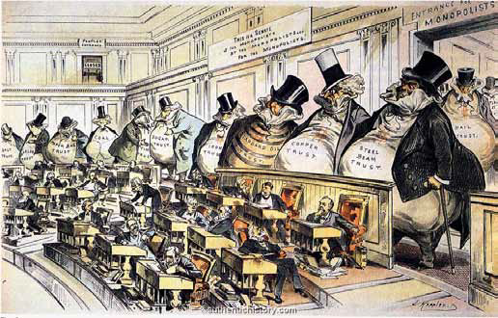

Slide 13
BIG SKY, BIG MONEY

Slide 14
Primary Source Worksheets

Slide 15
Citizens United Essay and Discussion

