Slide 1
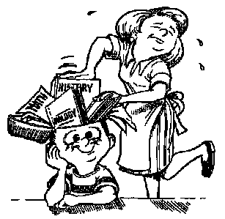
When and Why Memory Fails Us

Slide 2
7 Sins Of Memory 1. Transience 2. Absent-mindedness 3. Blocking 4. Misattribution 5. Suggestibility 6. Bias 7. Persistence

Slide 3
FORGETTING

Slide 4
Transience * Memories fade * Meaningful v. non-meaningful memories *Not all memories

Slide 5
Absent-mindedness *Retrieval failure from shifting attention *Not enough attention at time of encoding *Misplacing keys, forgetting appointments

Slide 6
Blocking *Tip-of-the-tongue *Information encounters interference *Similarity *Meaning *Emotional factors *Proactive v. Retroactive *Serial position effect

Slide 7
Proactive Interference * Forward acting * Something learned earlier disrupts recall of something experienced later * Teacher has trouble learning new names because of so many previous students

Slide 8
Retroactive Interference * Backward acting * New information makes it harder to recall something learned earlier * Teacher has trouble remembering old student names because she has learned new names from this year

Slide 9
RETRIEVAL FAILURE * Interference: learning something new will interfere with retrieval

Slide 10
DISTORTION

Slide 11
Misattribution *Memories associated with wrong time, place, person.

Slide 12
Suggestibility * Distortion/creation due to suggestion

Slide 13
Bias * Personal beliefs, attitudes and experience *Expectancy bias *Self-Consistency bias

Slide 14
INTRUSION

Slide 15
Persistence * Unwanted memories cannot be put out of mind

Slide 16
Think of an example for each “Sin” of memory.

