Slide 1
Sociological Theories * Structural Functionalist * Social Conflict * Symbolic Interaction

Slide 2
Structural Functionalist * Deviance is a necessary part of society. * Deviance, even crimes, serve an important function for society.

Slide 3
Emile Durkheim Deviance has some uses in social life. Deviance helps to 1. clarify norms 2. unify the group 3. promote social change. Deviance also helps to create jobs, such as law enforcement.

Slide 4
The Social Functions of Deviance: Clarifying Norms
Deviance serves to define the boundaries of acceptable behavior.
When rules are broken we are reminded of the norms that guide social life.
Punishment serves as a reminder that certain behaviors will not be tolerated by society.

Slide 5
The Social Functions of Deviance: Unifying the Group
Deviance also serves to draw the line between conforming members of society and “outsiders”, or the non-conforming members.
Reinforces the sense of community and the belief in shared values.

Slide 6
The Social Functions of Deviance: Promoting Social Change
Deviance can help prompt social change by identifying problem areas.
When large numbers of people violate a particular norm it is often an indication that something in society needs to be changed.

Slide 7
Strain Theory
Society tries to motivate everyone to strive for success
Society does not offer enough means for everyone to be successful
Strain is the frustrations people have because their route to success is blocked

Slide 8
How do people respond to strain 1. Conformity DEVIANT PATHS 1. Innovation 2. Ritualism 3. Retreatism 4. Rebellion

Slide 9
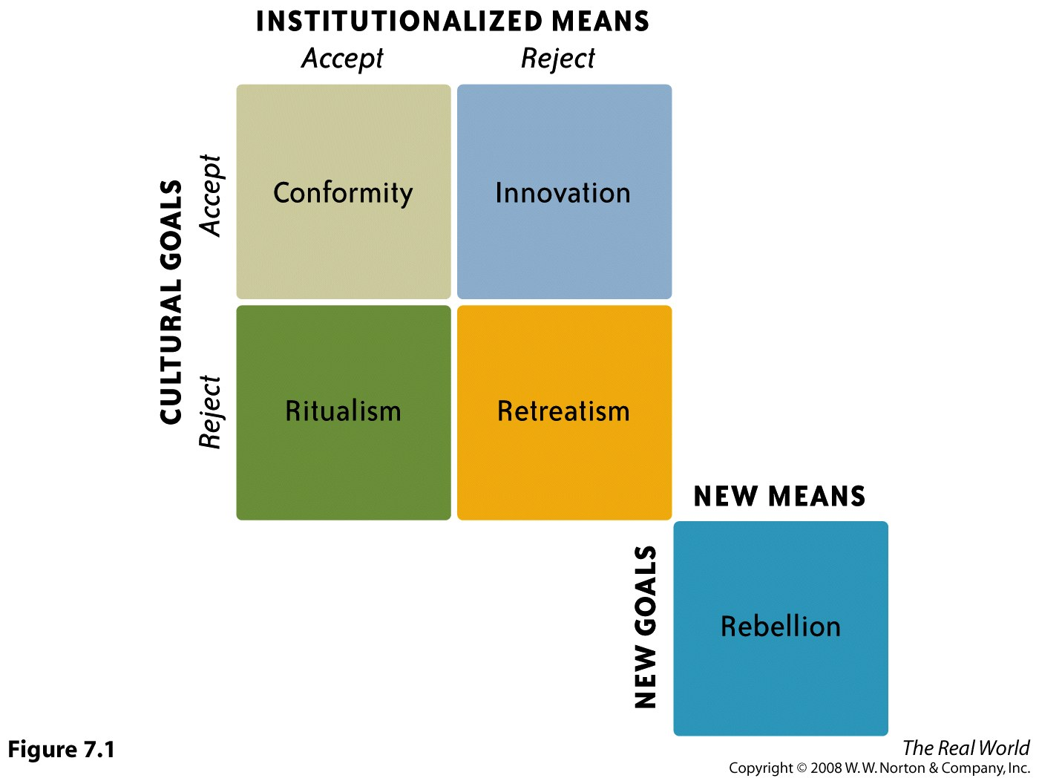

Slide 10
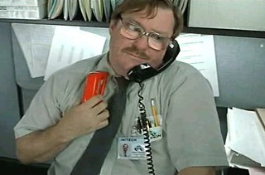
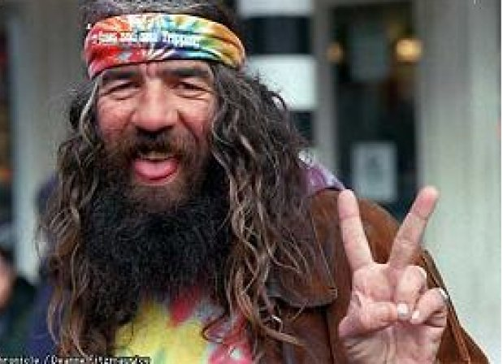
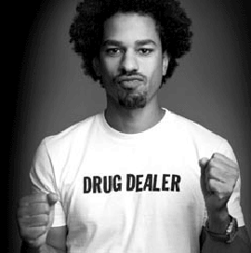
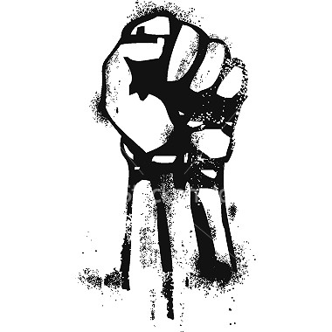
Conformist
Ritualist
Rebel
Innovator
Retreatist

Slide 11
Social Conflict Perspective
Competition and social inequality lead to deviance.
There are those with power (Ruling Class) and those without (Lower Classes).
Ruling Class commits acts of deviance to maintain their power.
Lower Class commits acts of deviance to gain economic means or b/c of feelings of powerlessness.

Slide 12
Illegitimate Opportunity Structure
Notes:
Talk about white collar crime

Slide 13
Those defined as deviant typically are powerless. * Norms of society reflect interests of the rich and powerful. * Those in power have the means to resist labels of deviance.

Slide 14
Social Conflict theorists see the law as an instrument of oppression. Most of the inmates in the US are from low social classes and are non-white

Slide 15
Symbolic Interaction Theory Interactionists are more interested in the individual and the thoughts and feelings of that individual. How do people define deviance?
Notes:
Landlords who evict people who cant pay unreasonably high rents are just doing their job/business

Slide 16
Differential Association Theory From the different groups we associate with we learn to conform to or reject norms.

Slide 17
Control Theory Two control systems work against our motivations to deviate Inner Controls: conscience, ideas of right/wrong Outer Controls: family, friends, police Stronger bonds within society means more effective controls.

Slide 18
Labeling Theory
Deviance and conformity are not what people do but how people react to the actions.

Slide 19
Explaining Deviance
Perspective | Theory | Questions
Functionalist | Strain | How do individuals respond to culturally approved goals and the legitimate means of achieving them?
Conflict | Conflict | What is the result of competition and social inequality? (Deviance) Who decides what is deviant. (Ruling Classes)
Interactionist | Control | Why do people conform to norms? (The strength of social ties determines conformity.)
 | Differential Association | How do people learn conformity or deviance? (Through socialization, or interaction with others) Where does this learning mainly occur? (Primary Groups)
 | Labeling | How do people become identified as deviant? (Through secondary deviance, or being labeled as deviant)

Slide 20
THE BREAKFAST CLUB

