Slide 1
Personality Doodle Exercise

Slide 2
What is personality?
The psychological qualities that bring continuity to an individual in different situations and at different times

Slide 3
Theories of personality are explanations that attempt to tie together the important influences on individuals.

Slide 4
Perspectives on personality 1. Psychodynamic 2. Humanist 3. Social-Cognitive
Personality is in a constant state of change.
This change is shaped by internal needs/thoughts and external pressures

Slide 5
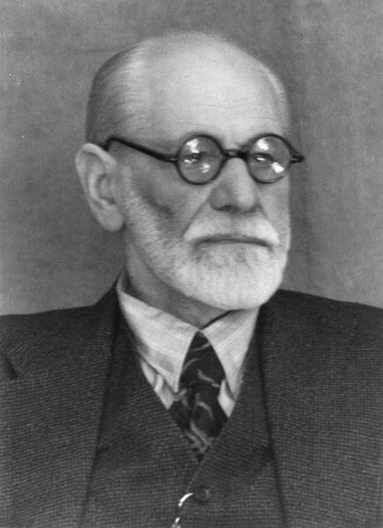
Psychodynamic Theory

Slide 6
* The Unconscious * Motives, desires, drives * How the mind’s energy is exchanged

Slide 7
Personality Structure (Freud) * Battle between two aggressive parts of personality

Slide 8
ID * Primitive, unconscious * Place for basic motives, drives and desires (determine our personality) * Childlike: always acts on impulses

Slide 9
ID * Immediate gratification *No concern for consequences * Only part present at birth

Slide 10
SUPEREGO *Police Force *Place for values and moral (learned from parents) *Common notion of conscience

Slide 11
SUPEREGO *Based on set of rules learned from parents/authority figures * Should not’s *Conflicts with ID

Slide 12
ID v. SUPEREGO
What feels good
What is right/moral

Slide 13
EGO * Conscious, rational *Resolves conflicts

Slide 14
Give me an example of when your ID, EGO AND SUPEREGO were all at work. (feel free to draw this)

Slide 15
PERSONALITY DEVELOPMENT * Predictable patterns * Forgotten experiences * Psychosexual stages

Slide 16
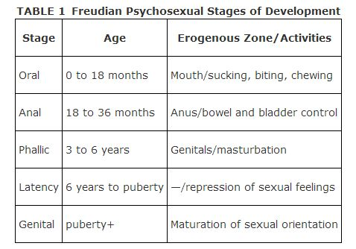

Slide 17
During the phallic stage (3-6 yrs) boys develop unconscious desires for their mothers and jealousy/hatred of their fathers. Freud called this the “Oedipus complex”.

Slide 18
Resolution of Oedipus Complex * Shift attraction to females in age group * Identify with fathers

Slide 19
Ego Defenses This is how the ego deals with the conflict between the ID and SUPEREGO

Slide 20
Repression-- Excludes unacceptable thoughts/feelings
Identification – Just as if it were you
Denial – Deny situation exists
Rationalization – Give socially acceptable reasons for actions

Slide 21
Reaction Formation – Opposite action of feelings
Displacement – Shifting reaction
Regression – Immature behaviors to deal with stress
Sublimation – Gratifying desires in acceptable ways
Projection -- Give our desires to other people

Slide 22
Carl Jung A disciple of Freud

Slide 23
The Collective Unconscious (2 parts) * Personal unconscious * Collective unconscious

Slide 24
Personal Unconscious * Same as ID * Contain Complexes Collective Unconscious * Place for instinctive “memories” that all people have * Create archetypes

Slide 25
Complexes * Seen in the personal unconscious * Clusters of emotionally important thoughts * Power Complex

Slide 26
COMPLEX ACTIVITY

Slide 27
Alfred Adler * Individual psychology * Sub-set of psychoanalytical

Slide 28
* Believed the person to be an indivisible whole

Slide 29
Inferiority Complex * Deals with self-esteem and negative effects on health

Slide 30
Erik Erikson * Conflicts everyone must face in development * Development in stages *Problems in each stage *As people face challenges, personalities grow

Slide 31
Trust v. Mistrust * First stage requires a basic sense of trust * Inconsistent parenting, lack of physical closeness/warmth develops mistrust, insecurity, anxiety *Children unprepared for next stage

Slide 32
Autonomy v. Self-Doubt * Stage 2 * Comfortable sense of autonomy and worthiness * Harsh demands = self-doubt

Slide 33
Initiative v. Guilt * Children want to do things for themselves * Impossible degrees of self-control = guilt and inadaquacy

Slide 34
Competence v. Inferiority * Success in undertakings * Discouragement = inferiority

Slide 35
Back to Freud just for 4 minutes

