Slide 1
A day at the beach…..

Slide 2
CLASSICAL CONDITIONING “Once bitten, twice shy” Type of learning in which one learns to link two or more stimuli and anticipate events

Slide 3
Classical Conditioning: basic form of learning in which a stimulus that produces an innate reflex becomes associated with a previously neutral stimulus, which then acquires the power to elicit essentially the same response.

Slide 4
Ivan Pavlov *Behaviorism at work (ignore thoughts, feelings, motives) * Basic laws of learning same for all animals

Slide 5
EXPERIMENTS ON SALIVATION Salivation is usually a reflex triggered by stimuli that has a biological significance. Pavlov discovered reflexes could become associated with a new stimuli. This meant the connection could be learned.

Slide 6
Neutral stimulus: one without any reflex-provoking power + Natural reflex producing stimulus = Learned response

Slide 7
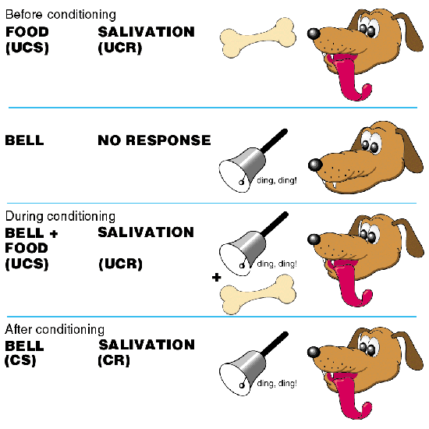

Slide 8
Unconditioned Stimulus (UCS): naturally and automatically produces a reflex response (food) Unconditioned Response (UCR): the unlearned, naturally occurring to the UCS (salivation) NO LEARNING INVOLVED HERE

Slide 9
During initial learning stages (acquisition) a neutral stimulus (tone) is paired with Unconditioned Stimulus. So, a tone is paired with food.

Slide 10
Eventually, the neutral stimulus with elicit the same results as the Unconditioned Stimulus. So, the tone will elicit salivation.

Slide 11
Therefore, the once neutral stimulus (tone), now becomes a Conditioned Stimulus (CS). The response to the Conditioned Stimulus (CS) now becomes the Conditioned Response (CR).

Slide 12
Conditioned Stimulus (CS): originally irrelevant stimulus, that after association with an UC comes to trigger a Condition Response Conditioned Response (CR): the learned response to a previously neutral stimulus

Slide 14
PRACTICE An experimenter sounds a tone just before delivering an air puff into your eye. After several repetitions, you blink to the tone alone.

Slide 15
UCS: Air Puff UCR: Blink to air puff CS: Tone before air puff CR: Blink to tone

Slide 16
Timing is critical for conditioning to work. In most cases, the CS and UCS (tone and food) must be presented close together in time.

Slide 17
5 CONDITIONING PROCESSES Acquisition: initial stage of learning, links between neutral stimulus and UCS Extinction: Learning from conditioning will go away (or decrease)

Slide 18
Spontaneous Recovery: Reappearance of conditioned response after a time delay

Slide 19
Generalization: Similar response to similar stimuli Discrimination: Opposite of generalization. Learning to respond to one stimulus but not to similar stimulus

Slide 20
Applications of Classical Conditioning Classical Conditioning can be used as a tool to eliminate unwanted behaviors. John Watson (behaviorist) first applied classical conditioning techniques to people

Slide 21
Examples Examples Examples Little Albert UCS: UCR: CS: CR:

Slide 22
Cognitive Processes? Food Aversions Drug Rehab Conditioning Coyotes

Slide 23
PRACTICE If the aroma of a cake sets your mouth watering what is the UC CS CR

Slide 24
Classical Conditioning Practice Worksheet

Slide 25
Your turn! Create a skit which you explain how classical conditioning works.

