Slide 1
Biopsychology and Neuroscience

Slide 2
How does the Brain Work? The Physical Basis of Mind and Behavior

Slide 3
What is biology and what does it have to do with psychology? NATURE V. NURTURE

Slide 4
Nature v. Nurture

Slide 5
Bio-psychology: intersection of biology, behavior, and mental processes. Neuroscience: collaboration between bio-psychologists, biologists, computer scientists, chemists, neurologists, linguists. Anyone interested in the connection between brain and mind.

Slide 6
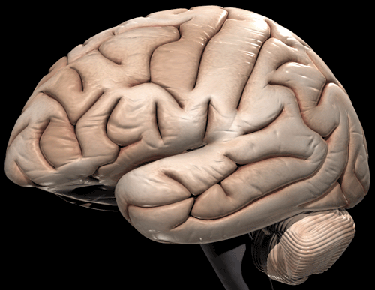
- Grapefruit sized - 3 lbs - 100 billion nerve cells
THE BRAIN

Slide 7
*Uses nerve circuitry * Regulates all body functions, control behavior, generate emotions and desires and process experiences. What does this have to do with psychology?

Slide 8
The brain has circuits capable of producing emotions, motives and insights. Biology motivates all human sensation and perception, learning and memory, passion and pain, reason and madness.

Slide 9
How are Genes and Behavior Linked?

Slide 10
Humans have innate abilities. Programmed for language, social interaction and self-preservation.

Slide 11
How did these abilities come to us? Evolution Change has favored large brains suited to language, problem solving and interaction.

Slide 12
Evolution can make sense of things that seem arbitrary. Example: Phobias almost always involve things that signaled danger to ancestors.

Slide 13
Inheriting Genes Genes encode information that can become your traits. Genetic code is similar to a CD which has music or pictures on it.

Slide 14
Unique combination of traits: Hair color, weight, height, facial features. Temperament and behavior patterns.

Slide 15
Genotype: genetic pattern that makes you different. Phenotype: Physical structure

Slide 16
Every cell nucleus in the body carries complete set of instructions for building the organism. Humans have 23 pairs of chromosomes. Each has a chain of DNA.

Slide 17
Genes are words that make up instruction manual. Humans have approximately 30,000 genes. Genes live on 46 chromosomes – arranged in 23 pairs.

Slide 18
What does this have to do with psychology? Genes influence psychological characteristics and physical traits.

Slide 19
Homework: What if you could choose the genes in your children? 1. Agree or disagree with developing such technology 2. Choose 3 genes you would pick for your child 3. Draw your genetically “perfect” child

