Slide 1
ALTERED STATES OF CONSCIOUSNESS

Slide 2
What Other Forms Can Consciousness Take Hypnosis Meditation Drug state

Slide 3
An altered state of consciousness occurs when some aspect of normal consciousness is modified by mental, behavioral, or chemical means.

Slide 4
Altered States of Consciousness are NOT mysterious or paranormal. They are modifications of ordinary consciousness that can be studied.

Slide 5
The “desire to alter consciousness periodically is an innate, normal drive analogous to hunger or the sexual drive” - Andrew Weil

Slide 6
Why would someone want to alter their state of consciousness?

Slide 8
Power of hypnosis is in the subject’s ability to be open to suggestion. Hypnotic suggestions promote concentration and relaxation.

Slide 9
State of awareness characterized by deep relaxation and focused attention. In some cases, people can ignore pain, remember details and create hallucinations. IS HYPNOSIS AN ALTERED STATE?

Slide 10
Ordinary sleep (cycles) play NO role in hypnosis – even though many subjects appear to be asleep.

Slide 11
EFFECTS OF SOCIAL INFLUENCE ON HYPNOSIS Good hypnotic subjects DISSOCIATION Split between levels of consciousness

Slide 12
Meditation

Slide 13
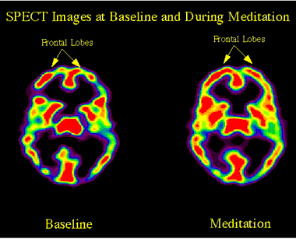
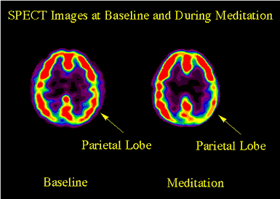
Focusing attention
Orientation with space and time

Slide 14
Meditation can be used to direct consciousness away from concerns and temptations. Meditation is used to seek spiritual enlightenment, increase self-knowledge and well-being.

Slide 15
East verses West

Slide 16
DRUGS

Slide 17
Psychoactive drugs are chemicals that change perceptions and moods. Psychoactive drugs act on neural synapses and there is little debate they alter consciousness

Slide 18
To some extent psychoactive drugs impair the brain mechanisms helping us to make good decisions. Other drugs stimulate “reward circuits”. Drugs such as cocaine, heroin and amphetamines trick our brains into exploiting these mechanisms with pleasure signals.

Slide 19
DEPENDENCE AND ADDICTION Tolerance: diminishing effect with regular use of the same dose of a drug Withdrawal: discomfort and distress that follow discontinuing the use of an addictive drug Physical dependence v. Psychological dependence

Slide 20
Psychoactive Drugs Depressants (Alcohol, Barbiturates, Opiates) Stimulants (Caffeine, Nicotine, Amphetamines, Cocaine, Ecstasy) Hallucinogens (Psychedelics)

Slide 21
Why would people want to alter their states of consciousness using psychedelic drugs?

Slide 22
PROBLEM SOLVING?

Slide 23
. . . a quote from Steve Jobs to New York Times reporter John Markoff, who interviewed him for his 2005 book What the Dormouse Said: How the Sixties Counterculture Shaped the Personal Computer. Speaking about his youthful experiments with psychedelics, Jobs said, "Doing LSD was one of the two or three most important things I have done in my life." He was hardly alone among computer scientists in his appreciation of hallucinogenic and their capacity to liberate human thought from the prison of the mind. And he credited his use of LSD as a major reason for his success.

Slide 25
Thinking differently--or learning to Think Different, as a Jobs slogan has it--is a hallmark of the acid experience. "When I'm on LSD and hearing something that's pure rhythm, it takes me to another world and into anther brain state where I've stopped thinking and started knowing," Kevin Herbert told Wired magazine at a symposium commemorating Hofmann's one hundredth birthday. Herbert, an early employee of Cisco Systems who successfully banned drug testing of technologists at the company, reportedly "solved his toughest technical problems while tripping to drum solos by the Grateful Dead." "It must be changing something about the internal communication in my brain," said Herbert. "Whatever my inner process is that lets me solve problems, it works differently, or maybe different parts of my brain are used."

Slide 26
What about art?

Slide 27
The Man Who Turned On America

